Slide 1
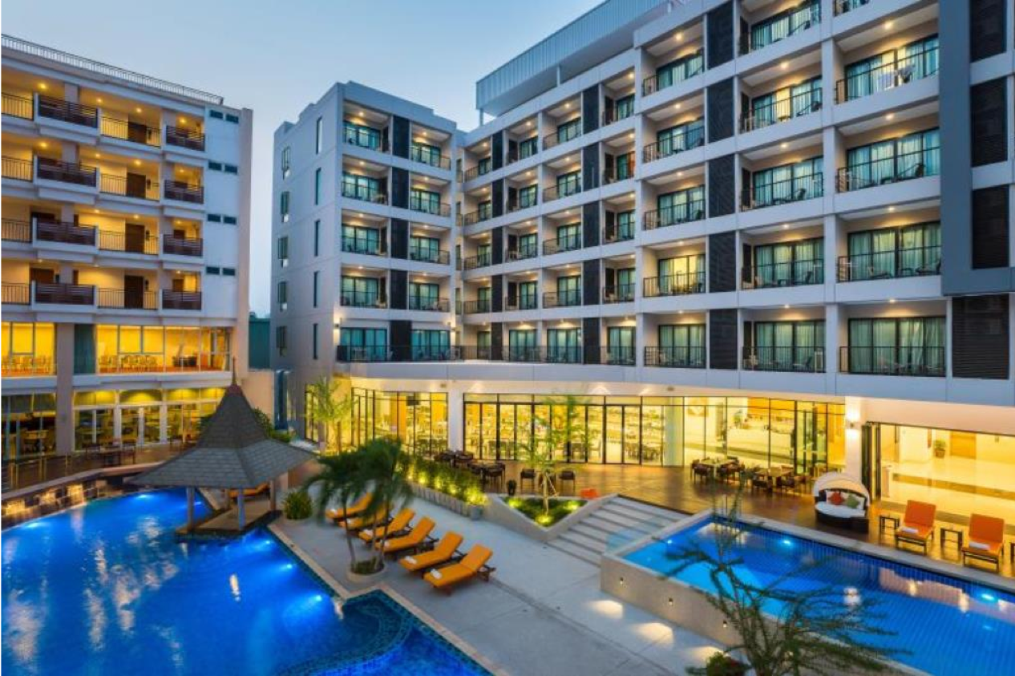


Expedia Hotel Recommendations
Which hotel type will an Expedia customer book?
Tong Xie
Yidan Xue
Yifeng Wang
Ningdong Wang
Weichen Zhang
Group 6

Slide 2
Contents
1
5
Business Goal
Business Insight
2
4
3
Data Understanding
Model Selection and Evaluation
Exploratory Data Analysis

Slide 3
Business Goal
PART 1
What big-data-driven business can we build from users’ behavior?

Slide 4


Business Goal
Predict the hotel type that a user would like to book
Provide 10 personalized hotel recommendations to travelers
Notes:
We want to take the proverbial rabbit hole out of Expedia’s hotel search by providing personalized hotel recommendations to travellers. Matching users with their preferences will essentially decrease the searching time cost and optimize the user experience (UE). Eventually, an increasing user stickiness will turn out a higher revenue for online travel agencies (OTAs).

Slide 5
Data understanding
PART 2
How are data generated?

Slide 6
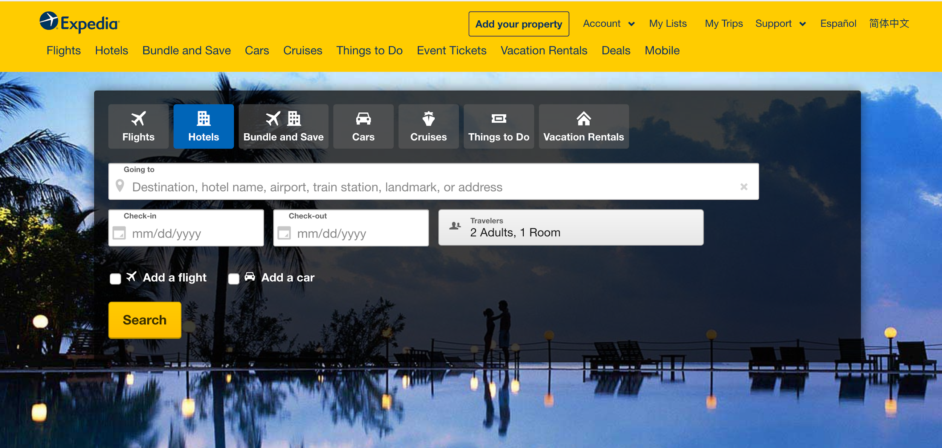
Expedia Website

Slide 7
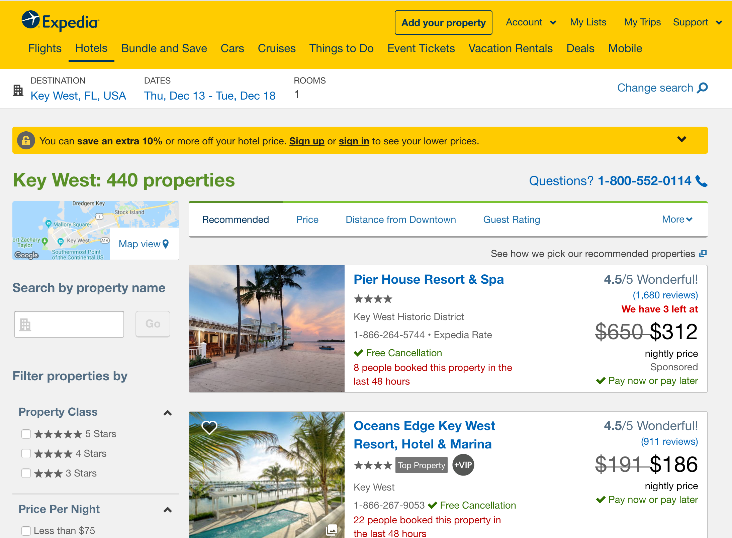
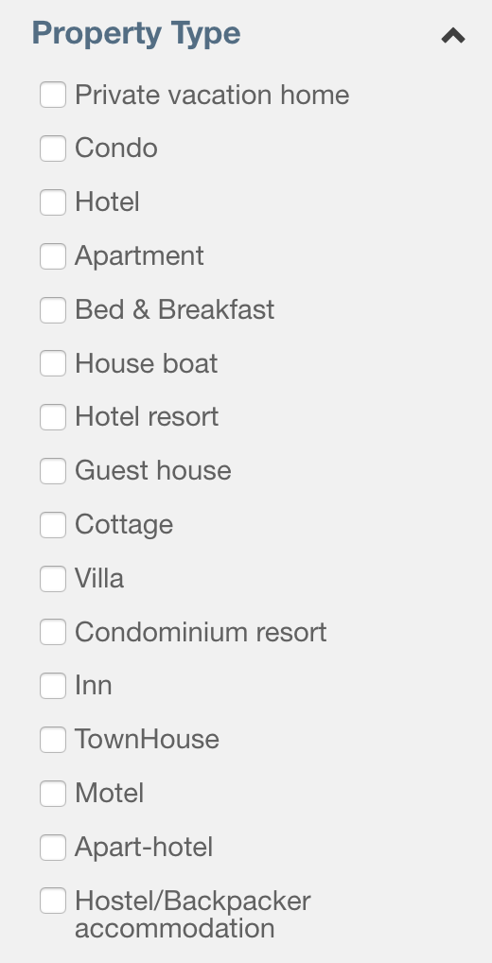
Search Result

Slide 8
Exploratory Data Analysis
PART 3
How does data look like? What expect variables can be created?

Slide 9
Challenges in Handling the Dataset
5 numerical variables
15 categorical variables
3 date/time variables
Target variable
192,014 rows
very different scales
at most over 10,000 unique values
noise,
outliers
100 levels
Masked data — difficult to group

Slide 10
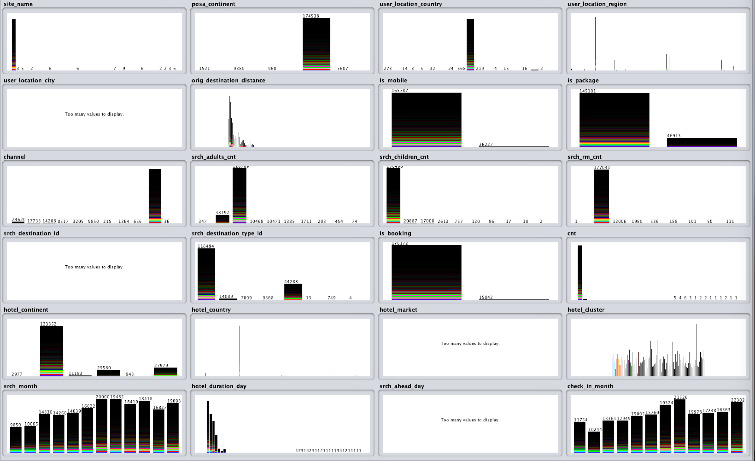
Visualization

Slide 11
Variable Creation
date_time Timestamp
srch_ci Check in date
srch_co Check out date
Expert Variable | Definition
hotel_duration_day | Days that users plan to stay in the hotel
srch_ahead_day | Days in advance that users plan a trip
srch_month | The month that users perform the search
check_in_month | The month that users plan to check in

Slide 12
Model Selection and
Evaluation
PART 4
Challenges and progress in the modeling process

Slide 13




Approaches we took
Hard to determine the type of distance for classification
Computationally intensive
First used grouped levels, 50% accuracy
Need to create a dummy variable for each categorical level,computationally intensive
Hard to choose a proper activate function for output layers to output more than one prediction with proper accuracy

Slide 14

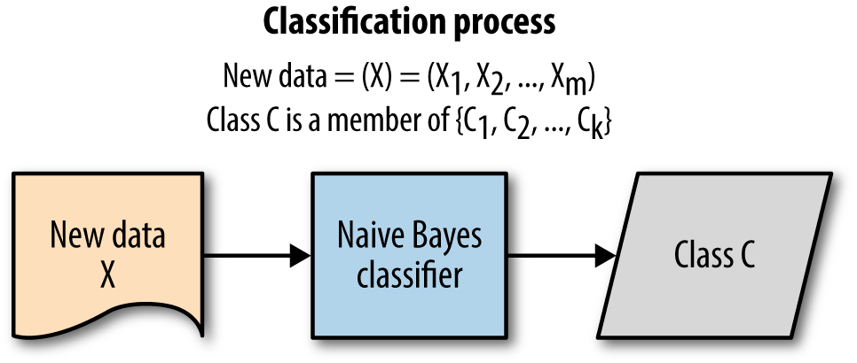
Improved Method
Easy and fast to predict the class of testing data set
When assumption of independence holds, Naive Bayes classifier performs better
Performs well with categorical input variables compared to numerical variables.
Notes:
For numerical variables, normal distribution is assumed

Slide 15
Improved Method
Suitable for datasets with many categorical variables
For 10 predictions,
1st Trial Accuracy: 30.0%
Aggregate numerical to categorical
2nd Trial Accuracy: 42.9%
Notes:
For numerical variables, normal distribution is assumed

Slide 16
Improved Method
Suitable for datasets with many categorical variables
For 10 predictions,
2nd Trial Accuracy: 42.9%
Laplacian Correction
3rd Trial Accuracy: 59.6%
To be continued...

Slide 17

Improved Method
Recap Assumption: independency among variables
hotel_continent and hotel_country
user_location_country and
user_location_region
have high correlation.
So, remove the former ones.
For 10 predictions,
3rd Trial Accuracy: 59.6%
Remove highly correlated attributes
4th Trial Accuracy: 60.3%

Slide 18

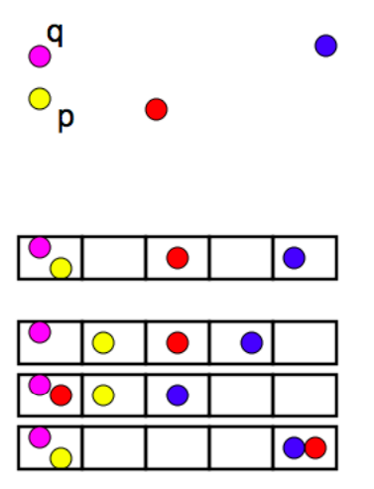
Further Steps
Commonly used to deduplicate large quantities of documents, webpages, and other files
Data points are hashed into buckets
Suitable for categorical variables with a large number of levels
Notes:
Commonly used to deduplicate large quantities of documents, webpages, and other files
Hash data points into buckets so that data points near each other are located in the same buckets with high probability

Slide 19
PART 5
Business Insights
To which business scenario can we apply our model?

Slide 20


Business Insights
Make personalized booking recommendations based on user locations and destinations
Attract new customers
Develop existing customers’ loyalty
To Customers
Discover popular hotel types based on user search habits
Partner with hotels with a high booking frequency before competitors do
25% commission in one booking
To Business

Slide 21
Q&A

Slide 22
THANKS!

Slide 23
Appendix
How do hotel clusters look like?
Final Variables
Data Cleaning
Chi-Square Test of Independence

Slide 24
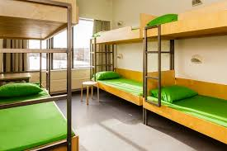

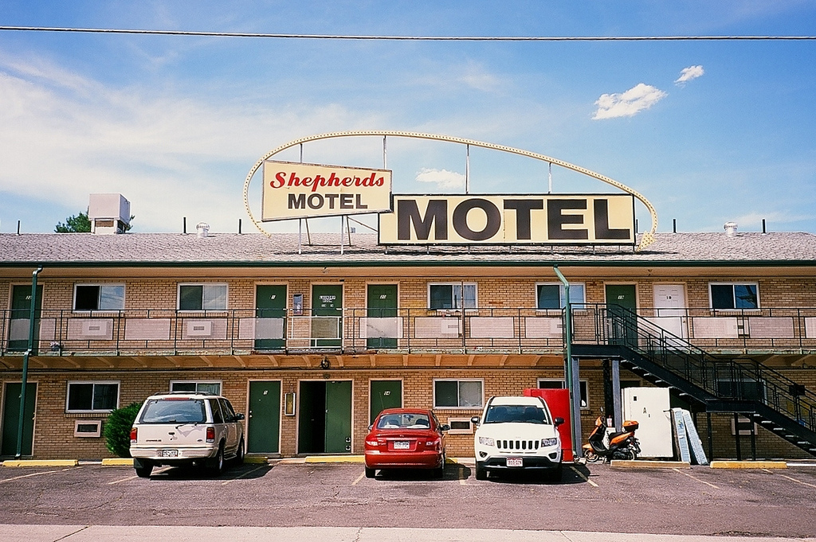
What is the “hotel cluster”?

Slide 25
Final Variable - Numeric
Numerical Variable | Description
orig_destination_distance | Physical distance between a hotel and a customer at the time of search
srch_adults_cnt | Number of adults specified in the hotel room
srch_children_cnt | Number of (extra occupancy) children specified in the hotel room
srch_rm_cnt | Number of hotel rooms specified in the search
cnt | Number of similar events in the context of the same user session
hotel_duration_day | (Check out date - Check in date) in days
srch_ahead_day | (Check in date - User search date) in days

Slide 26
Final Variable - Categorical (1)
Categorical Variable | Description | Number of levels
site_name | ID of the Expedia point of sale (i.e. Expedia.com, Expedia.co.uk, Expedia.co.jp, ...) | 36
posa_continent | ID of continent associated with site_name | 5
user_location_country | The ID of the country the customer is located | 19
user_location_region | The ID of the region the customer is located | 211
user_location_city | The ID of the city the customer is located | 6062
hotel_continent | Hotel continent | 6
hotel_country | Hotel country | 182
hotel_market | Hotel market | 1916
srch_month | The month that a user conducts the booking search | 12

Slide 27
Final Variable - Categorical (2)
Categorical Variable | Description | Number of levels
is_mobile | 1 when a user connected from a mobile device, 0 otherwise | 2
is_package | 1 if the click/booking was generated as a part of a package (i.e. combined with a flight), 0 otherwise | 2
channel | ID of a marketing channel | 11
check_in_month | The month that the check in date falls in | 12
is_booking | 1 if a booking, 0 if a click | 2

Slide 28
Final Variable - Categorical (3)
Categorical Variable | Description | Number of levels
srch_destination_id | ID of the destination where the hotel search was performed | 11365
srch_destination_type_id | Type of destination | 8
is_booking | 1 if a booking, 0 if a click | 2

Slide 29
Data Cleaning
Delete rows with null values in check in or check out dates
Delete variables that do not describe the user behavior: user ID
Delete categorical variables with over 10,000 levels
some categorical variables are overlapping (city, region, country)
keep those that make sense and with moderate and manageable levels

Slide 30
Categorical Variable | p-value
site_name | 0
posa_continent | 0
user_location_country | 0
user_location_region | 0
user_location_city | 0
is_mobile | 9.090527e-69
is_package | 0
channel | 0
srch_destination_id | 0
srch_destination_type_id | 0
is_booking | 0
hotel_continent | 0
hotel_country | 0
hotel_market | 0
srch_month | 1.563823e-190
check_in_month | 0
Chi-Square Test of Independence
Conducted Chi-square test between each categorical variable and the target variable.
All the p values are smaller than 0.05, therefore we reject the hypothesis of independence.
All the categorical variables are correlated to the target variable.

Slide 31
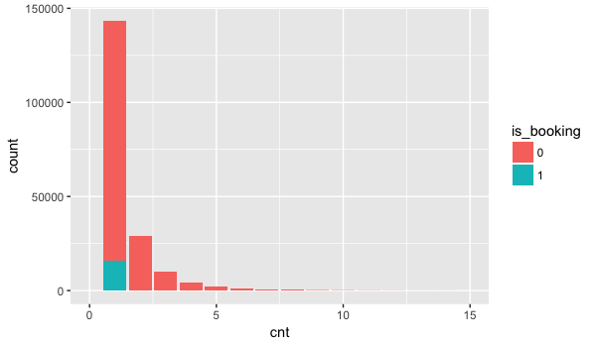


cnt filled by is_booking
Number of similar events in the context of the same user session
1 if a booking, 0 if a click
Specific destination
Well-prepared travel plan
More valuable users
Just looking around...

